Slide 1


Slide 2
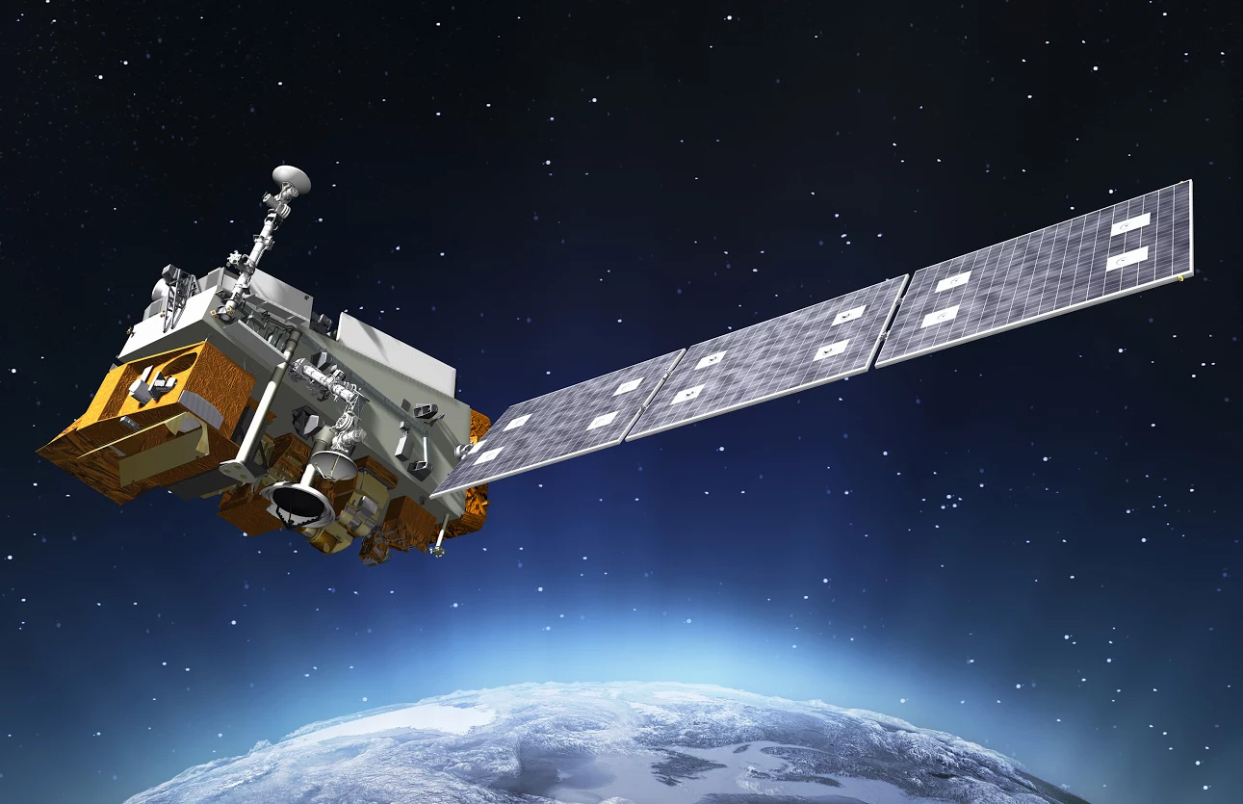
S-Band Communication Subsystem for CubeSat (Spirit)
Daniel Rea
Jiayong Song
Rajja Singh
Zhengxing Liu

Slide 3
Table of Contents
Background Information
Modulation Scheme Tradeoff
Component Selection
Link Budget
Constraints
Prototype Design
Prototype Functionality
Questions

Slide 4
Table of Contents
Background Information
Modulation Scheme Tradeoff
Component Selection
Link Budget
Constraints
Prototype Design
Prototype Functionality
Questions

Slide 5
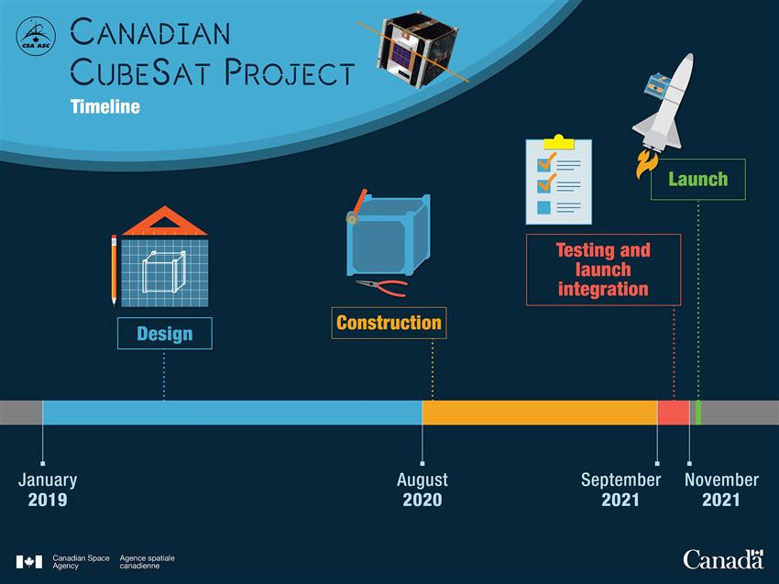

Slide 6
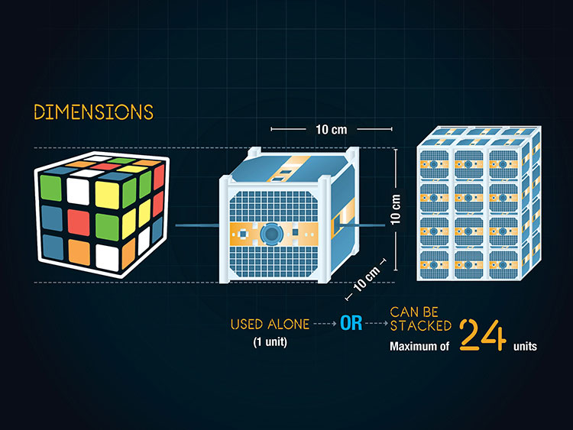
Background Information
What is a CubeSat?

Slide 7
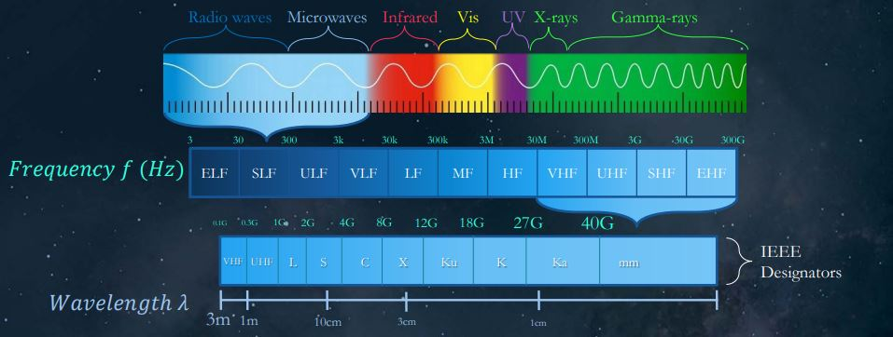
S-Band

Slide 8
Table of Contents
Background Information
Modulation Scheme Tradeoff
Component Selection
Link Budget
Constraints
Prototype Design
Prototype Functionality
Questions

Slide 9
Modulation Scheme Trade-off

Slide 10
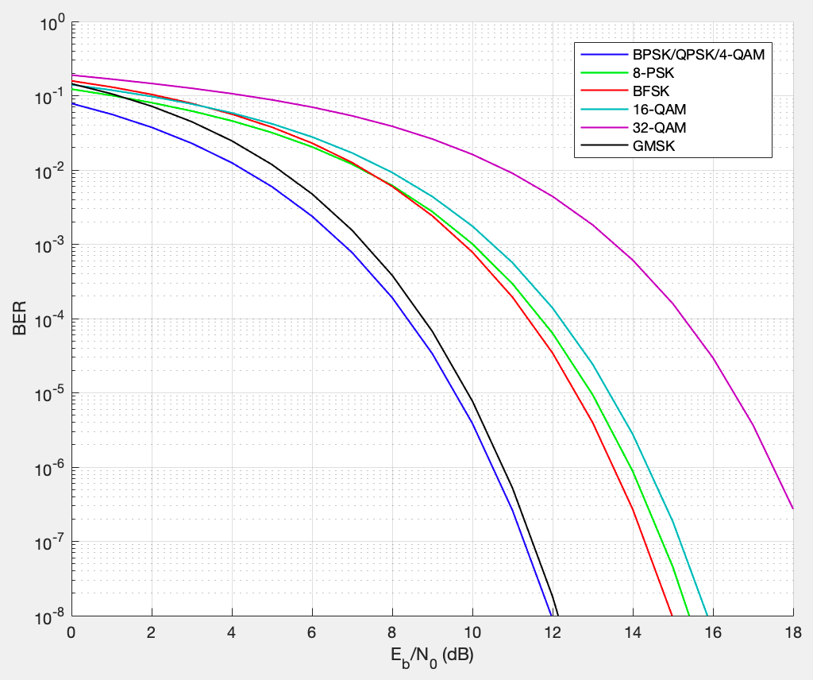
Bit Error Rate vs SNR/bit

Slide 11
Table of Contents
Background Information
Modulation Scheme Tradeoff
Component Selection
Link Budget
Constraints
Prototype Design
Prototype Functionality
Conclusion

Slide 12
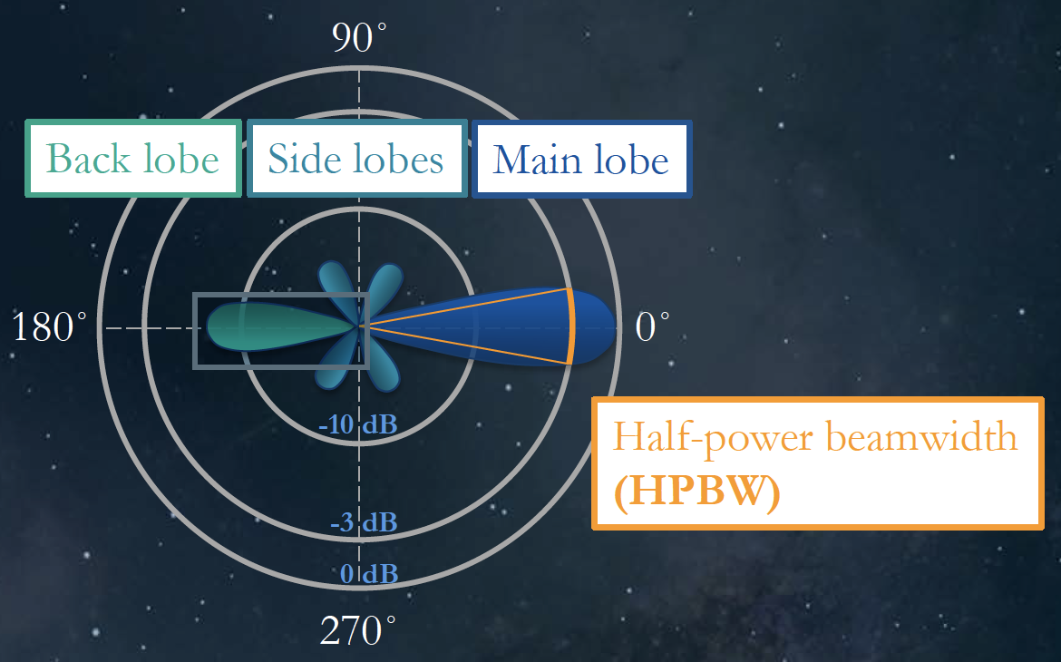
Antenna Selection
Trade-off: Radiation Directivity vs Power Gain

Slide 13
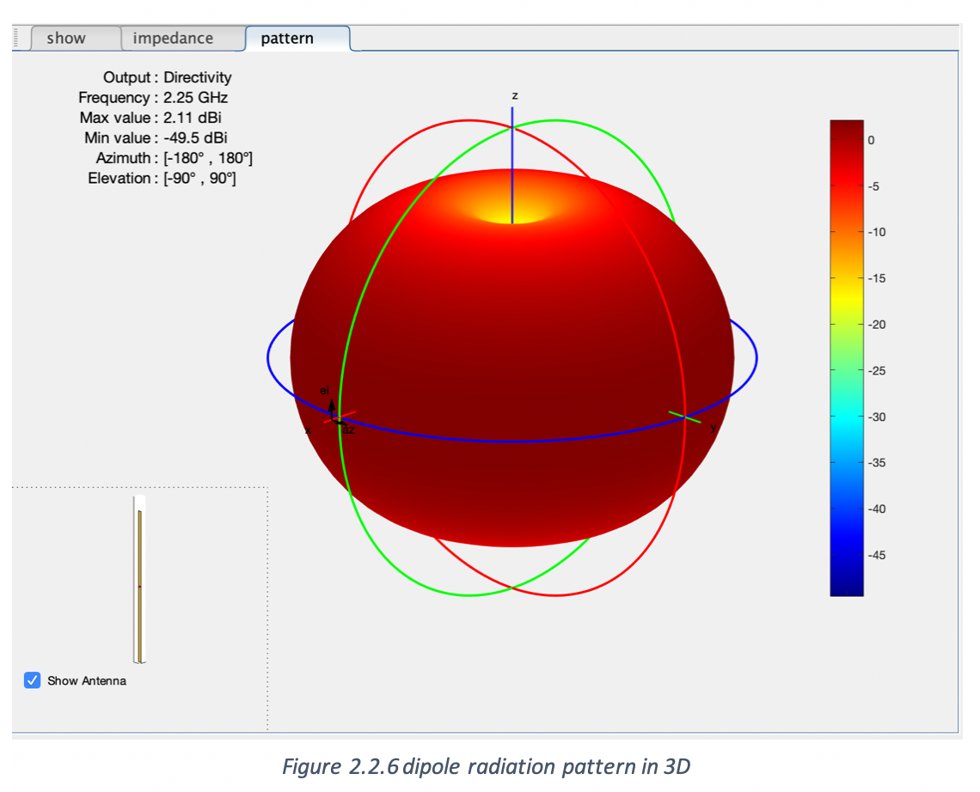
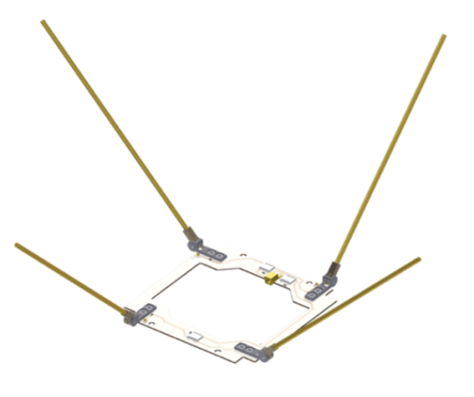
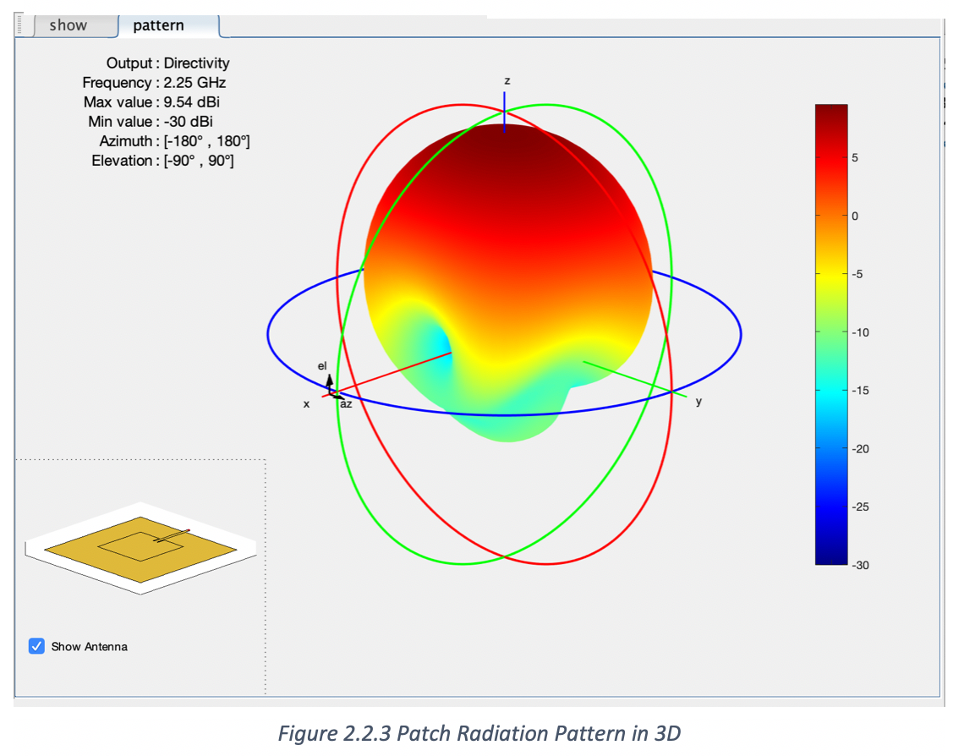
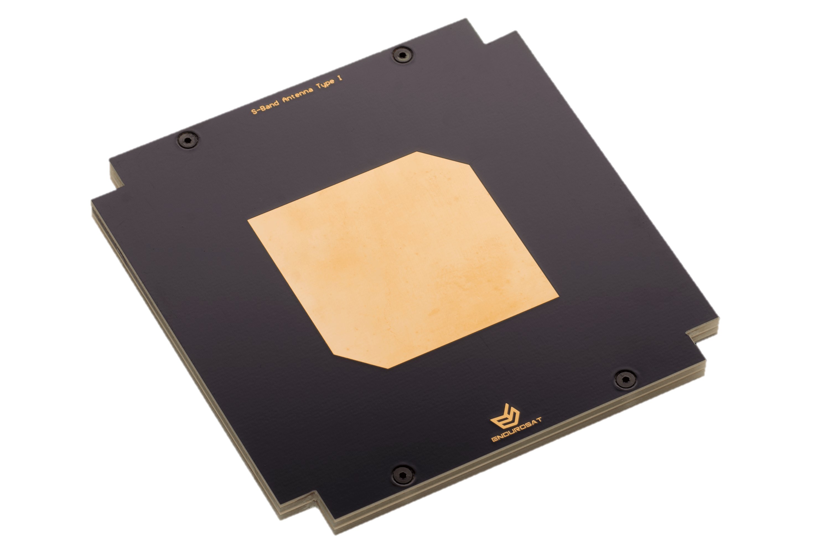
Dipole Antenna
Omni-directional in azimuth plane
Toroidal in elevation plane
80˚ beamwidth
2.11 dBi
Patch Antenna
High directionality in elevation plane
59˚ beamwidth
9.53 dBi

Slide 14
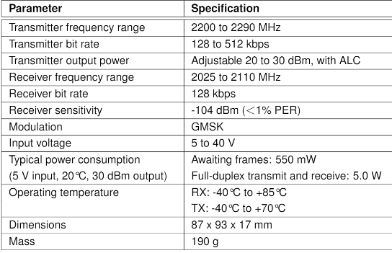
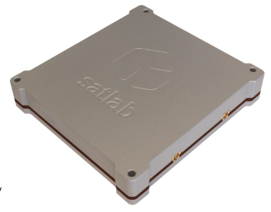
Full Duplex Low Power S-Band Transceiver

Slide 15
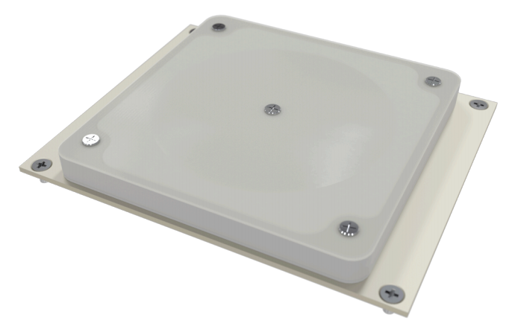
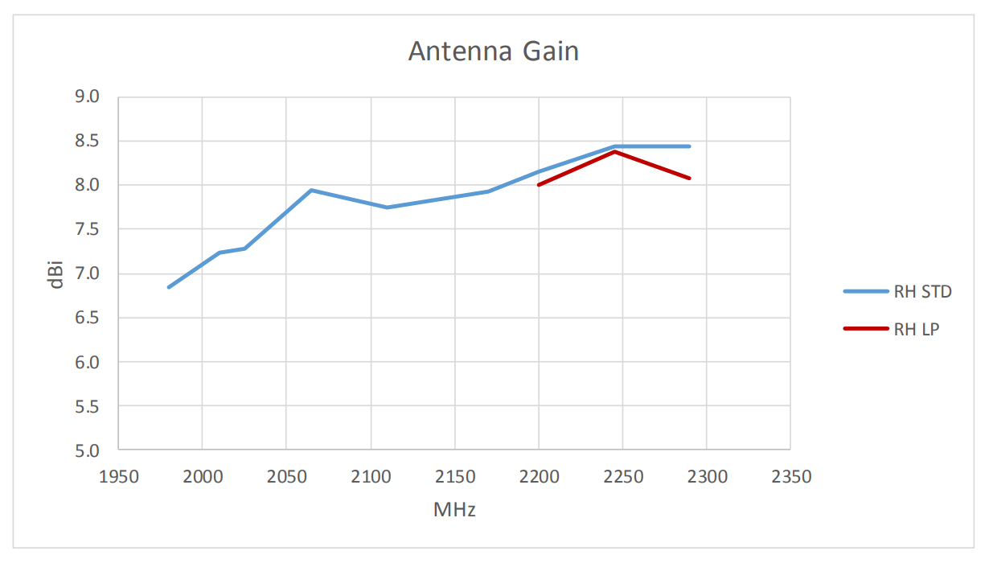
NanoCom ANT2000 – Patch Antenna
Antenna gain at 2.2GHz = 8.3 dBi
Frequency Range

Slide 16
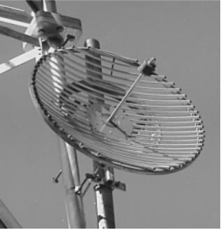
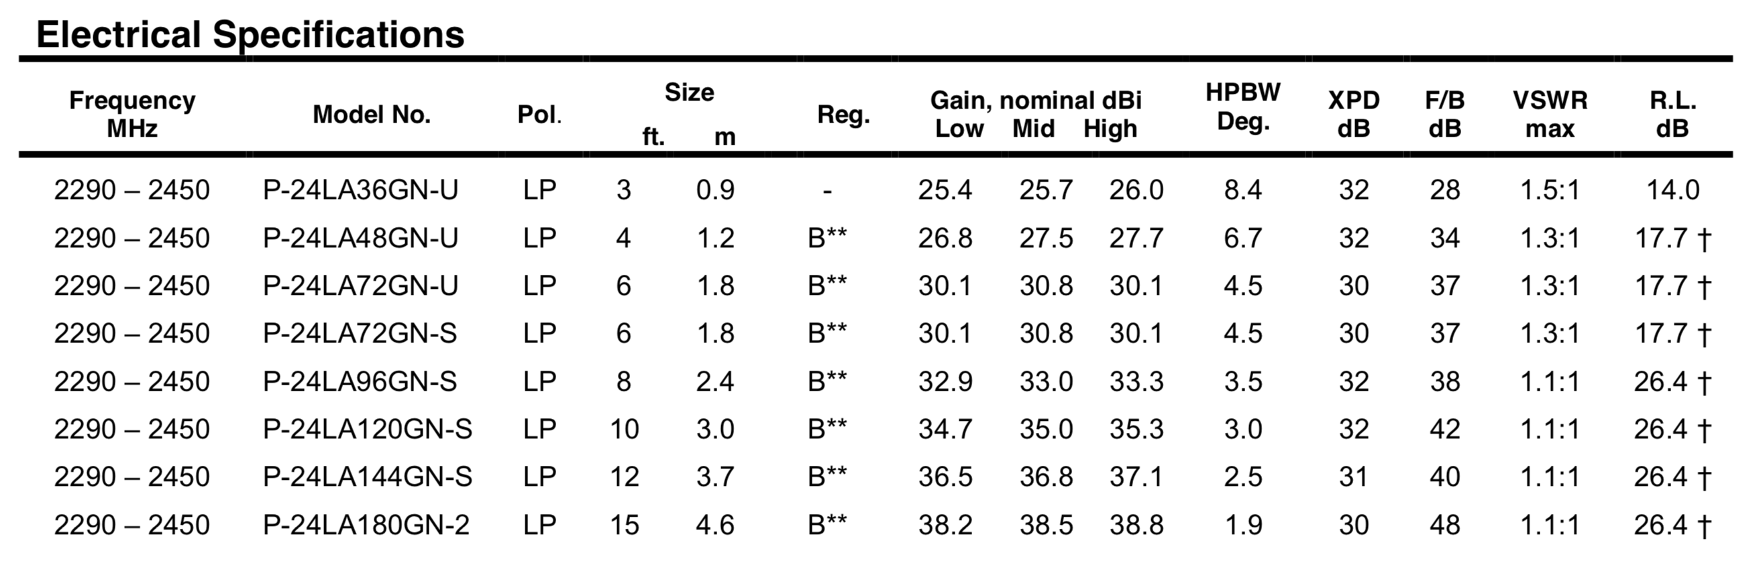
Ground Station Antenna
Ground Station Antenna:
Parabola grid antenna
1.8m diameter
4.5° beamwidth
30 dBi gain

Slide 17
Table of Contents
Background Information
Modulation Scheme Tradeoff
Component Selection
Link Budget
Constraints
Prototype Design
Prototype Functionality
Conclusion

Slide 18
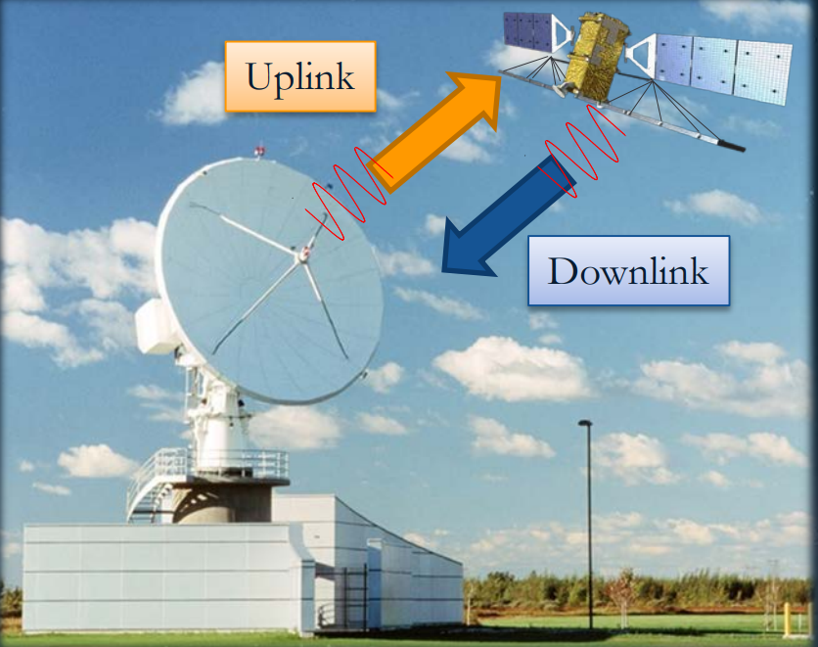
Link Budget
The accounting of all the signal gains and losses to ensure that the signal intended for a given receiver is strong enough to get the job done.

Slide 19
Bandwidth Calculation
For occupied bandwidth (99% power interval):
BW = NPSD * R
BW: Occupied bandwidth
NPSD: Normalized power spectral density
R: Bit rate

Slide 20
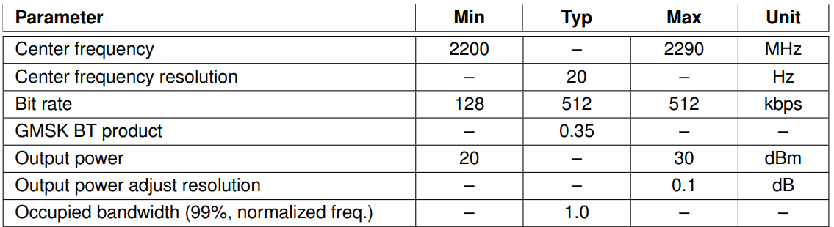
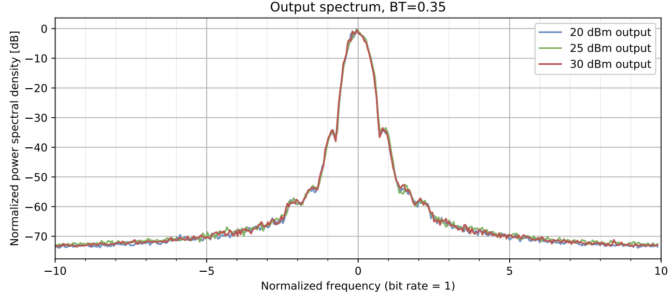
Bandwidth Calculation
0 dB, NPSD = 1

Slide 21
Bandwidth Calculation
BW = 1*Bit rate
Bit rate range: 128 kbps – 512 kbps
Bandwidth range: 128 kHz – 512 kHz

Slide 22
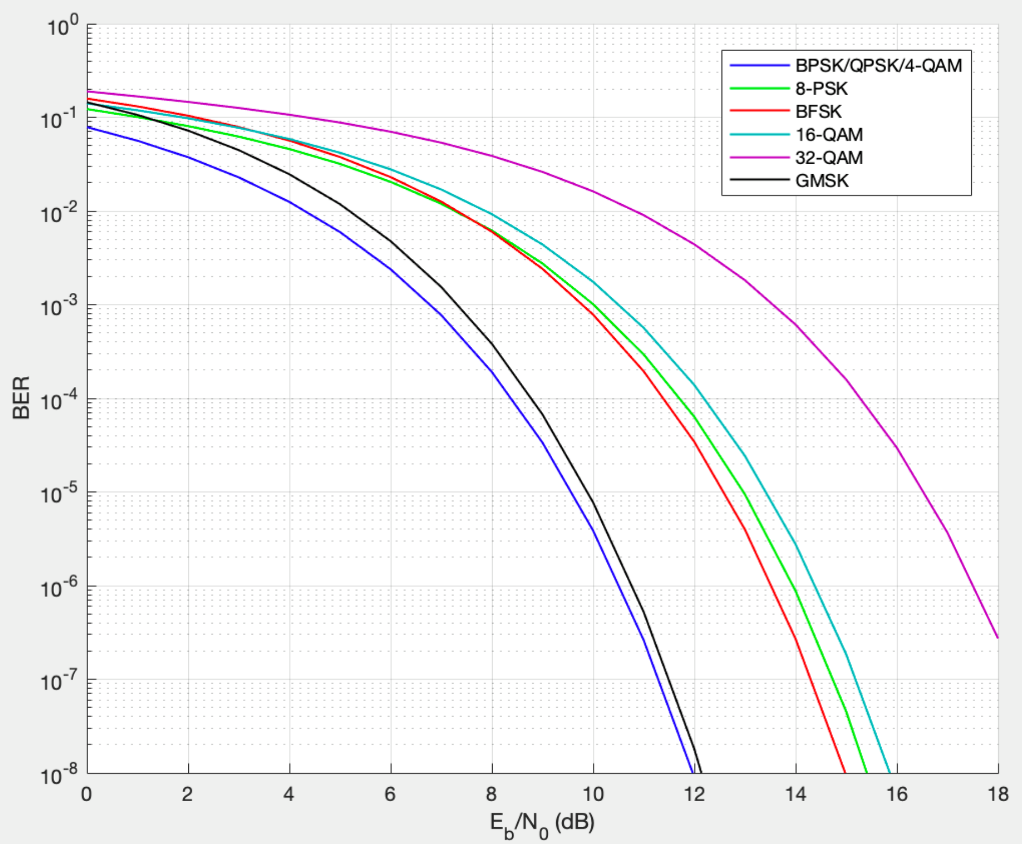
Signal-to-Noise-Ratio (SNR)
SNR Calculation
Bit-error-rate Vs Eb/No for various modulation schemes
SNR = $\frac{Signal power}{Noise power}$
$$= \frac{E_{b}}{N_{o}} ∗Modulation Efficiency$$
$\frac{E_{b}}{N_{o}}$: Normalized SNR (SNR per bit)
GMSK (BT = 0.35)
BER = ${10}^{−5}$, $\frac{E_{b}}{N_{o}}$ =10

Slide 23
Required SNR
Required SNR
= $\frac{E_{b}}{N_{o}} ∗Modulation Efficiency$
=10 *1 = 10 =10dB
To verify:
Calculate SNR by $\frac{Signal power}{Noise power}$
Use parameters from antennas and transceivers.

Slide 24
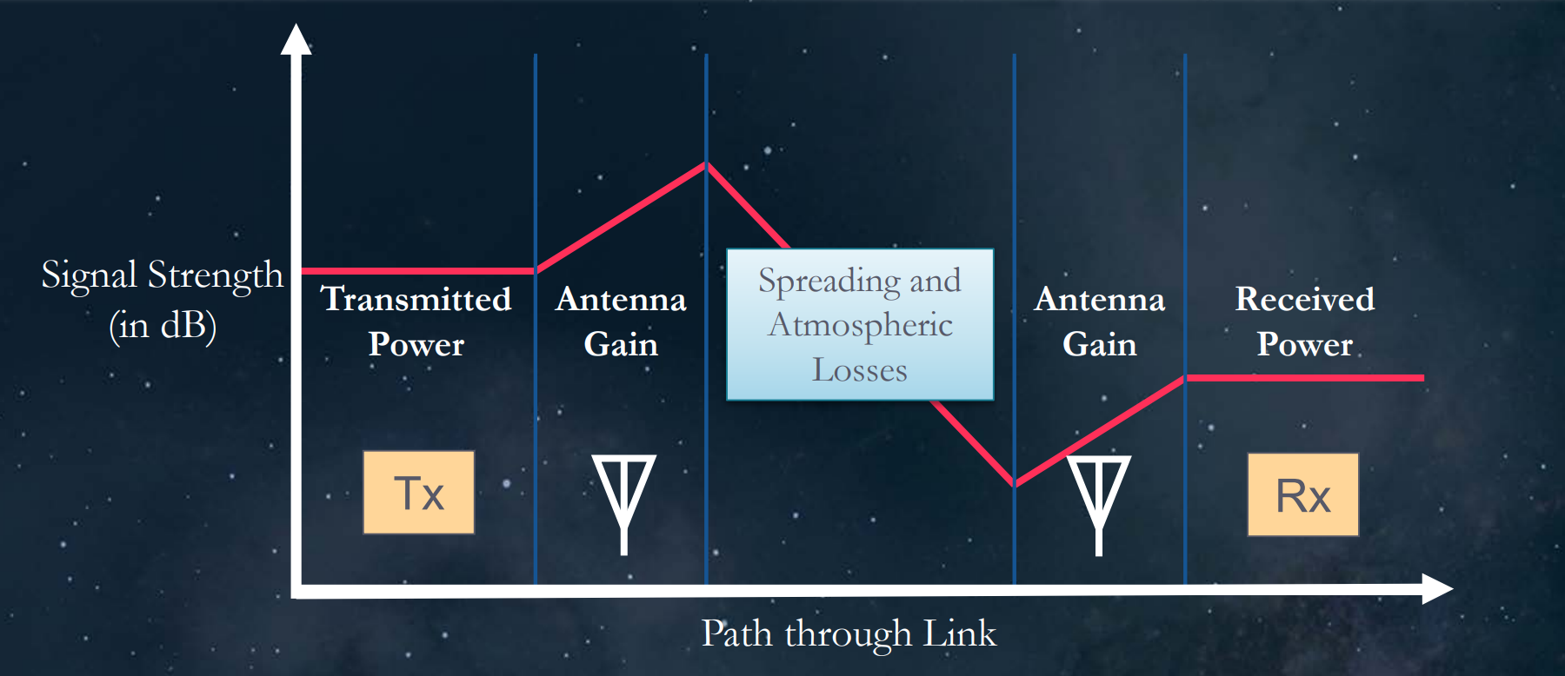
Basic Link Path
$$Transmitted power$$
$$Propagation$$
$$losses$$
$$Received power$$
$$System Noise$$

Slide 25

Antenna Received Power ($P_{re}$)
P_{re} = $\frac{P_{t}∗G_{r}∗G_{t}∗λ^{2}}{{(4∗π∗d)}^{2}}$
Pt: power transmitted = 30 dBm = 1W
Gr: tansmitting antenna gain = 8.2 dBi = 6.61
Gt: receiver antenna gain = 30.8 dBi = 1200
λ: wavelength = 0.136 m
d: Distance between Earth and CubSat = 408 km
P_{re} = $\frac{1∗6.61∗1200∗{0.136}^{2}}{{(4∗π∗408000)}^{2}}$ = 2.512*10⁻¹² W = -116 dBW

Slide 26
System Noise Power
N_{sys} = KT_{sys}B
K: Boltzmann's Constant = 1.38*10⁻²³ J/K
T_{sys}: Antenna system noise temperature in Kelvin
B: Bandwidth

Slide 27
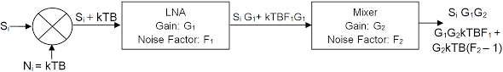
System Noise Temperature
Typical antenna receiving system
Receiver internal noise temperature:
T_{E} = Tt + (Lt)T_{RF} + (L_{t}/G_{RF})T_{M} + (L_{t}*L_{m}/G_{RT})T_{IF}
Passive attenuator feedline & mixer:
T_{t} = (L_{t}-1)T₀ , T_{m} = (L_{m}-1)T₀
T₀ = physical temperature of receiver components
L_{t}/L_{m}: loss(attenuation) factor of feeder line and mixer
G_{RF}: gain of RF amplifier

Slide 28
System Noise Temperature and Power
Antenna Noise Temperature | T_{A} | Main lobe & side lobes 100% effiency | 103 | K | 20.13 | From the graph below
Antenna Physical Temperature | T_{Ao} | Ground Temperature | 290 | K | 24.62 | Ground Station
Effective Internal Noise Temperature | T_{E} | Assume a LNA amplifier | 2064.92 | K | 33.15 | Assumption
Antenna Radiative Effiency | ξ_{r} | Assume 80% effiency | 0.8 | N/A | N/A | Assumption
System Noise Temperature | T_{sys} | T_{sys} = T_{A}*ξr + (1-ξ_{r})*T₀ + T_{E} | 2205.32 | K | 33.43 | Toal noise temperature
Antenna Average Noise Power | N_{sys} | N_{sys} = K*T_{sys}*B | 1.56E-14 | W | -138.07 | Average Noise power
Antenna received power = -116 dB
Antenna Average Noise Power = -138.07 dB
SNR = $\frac{P_{re}}{N_{sys}}$ = 22.07 dB
Required SNR = 10 dB
SNR margin = 12.07 dB
(Good design, margin > 3dB)

Slide 29
Table of Contents
Background Information
Modulation Scheme Tradeoff
Component Selection
Link Budget
Constraints
Prototype Design
Prototype Functionality
Questions

Slide 30
Constraints for Prototyping
S-Band amateur frequencies
CubeSat ready components are too expensive
Distance Testing must be smaller scale
Need prototype to validate aspects of design

Slide 31
Table of Contents
Background Information
Modulation Scheme Tradeoff
Component Selection
Link Budget
Constraints
Prototype Design
Prototype Functionality
Questions

Slide 32
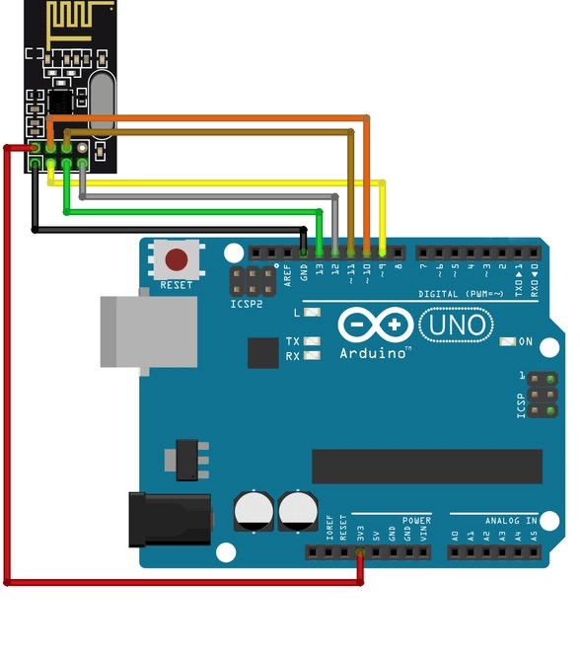
Arduino
+
NRF24L01 transceiver module
2.4 GHz wifi frequency

Slide 33
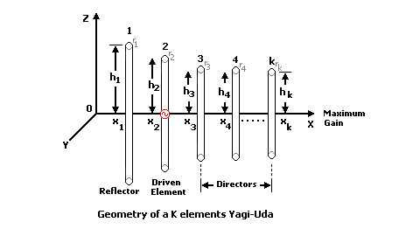
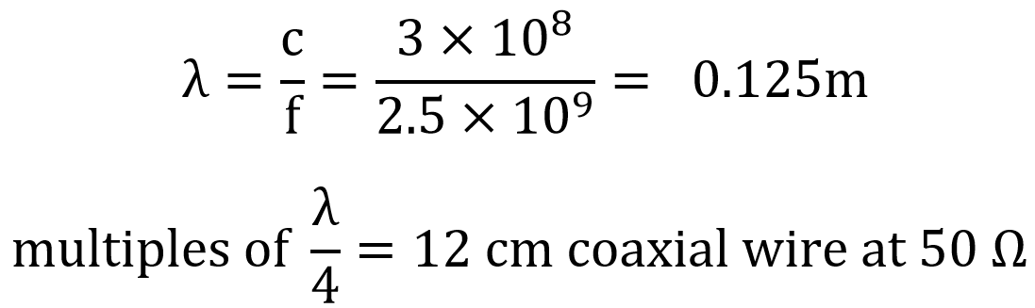
Prototype Fabrication
Antenna soldered onto NRF24L01 chip to improve antenna gain
Dipole and Yagi Uda Antenna
Add additional coaxial wire as transmission Line for Matching Circuit

Slide 34
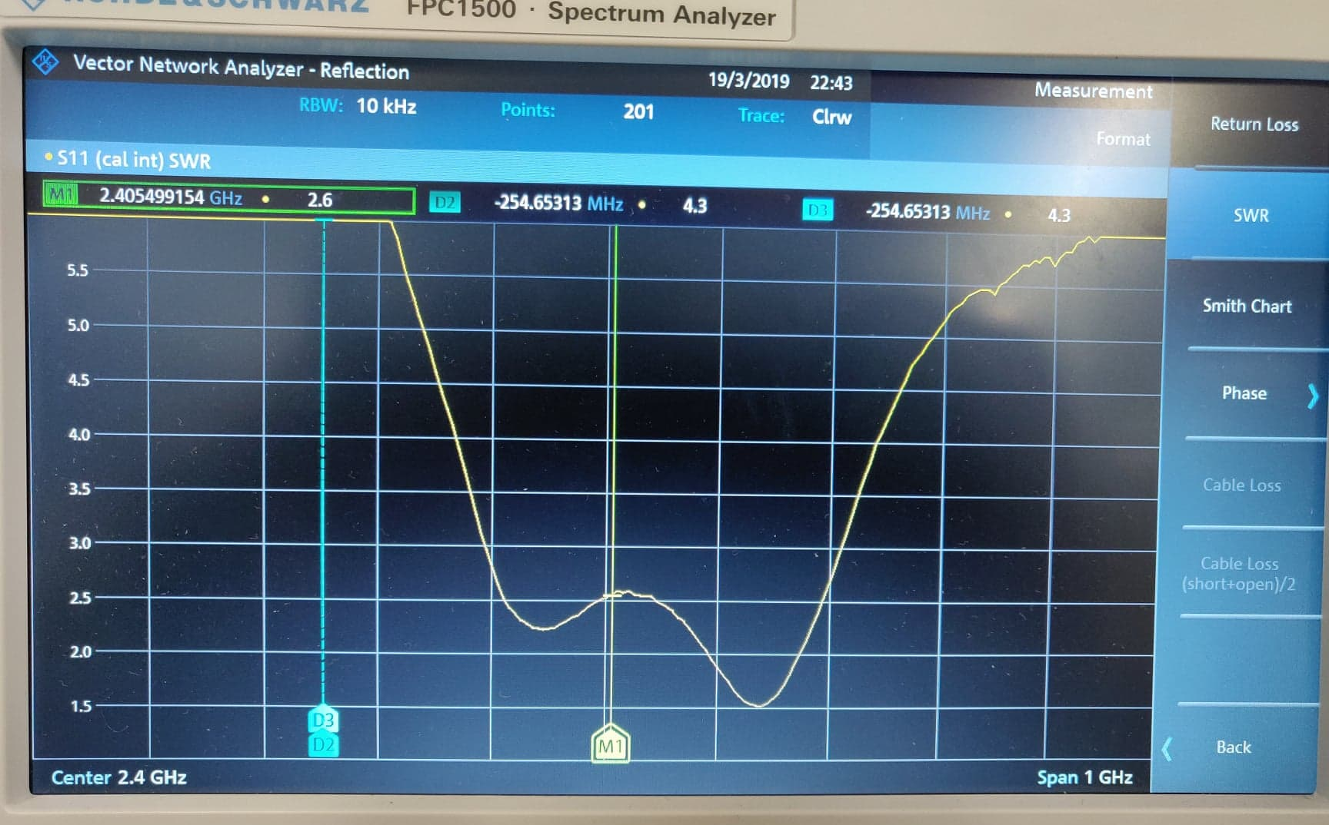
Standing Wave Ratio (SWR)
measure of impedance matching of loads to the characteristic impedance of a transmission line or waveguide
SWR = 2.6, measured from spectrum analyzer

Slide 35
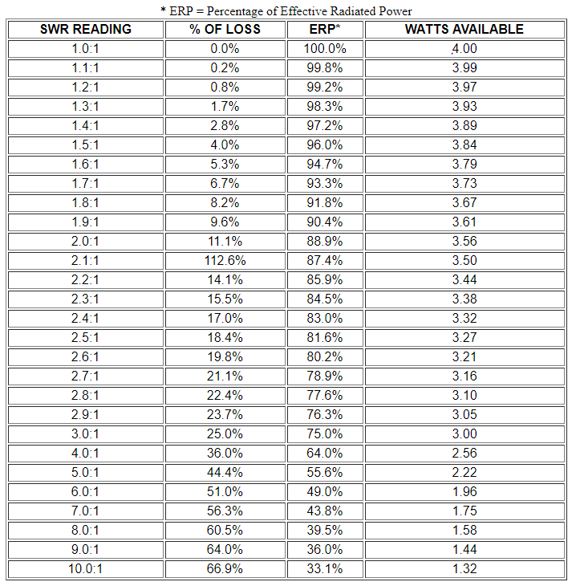
At SWR = 2.6
Line loss ≈ 20 %

Slide 36
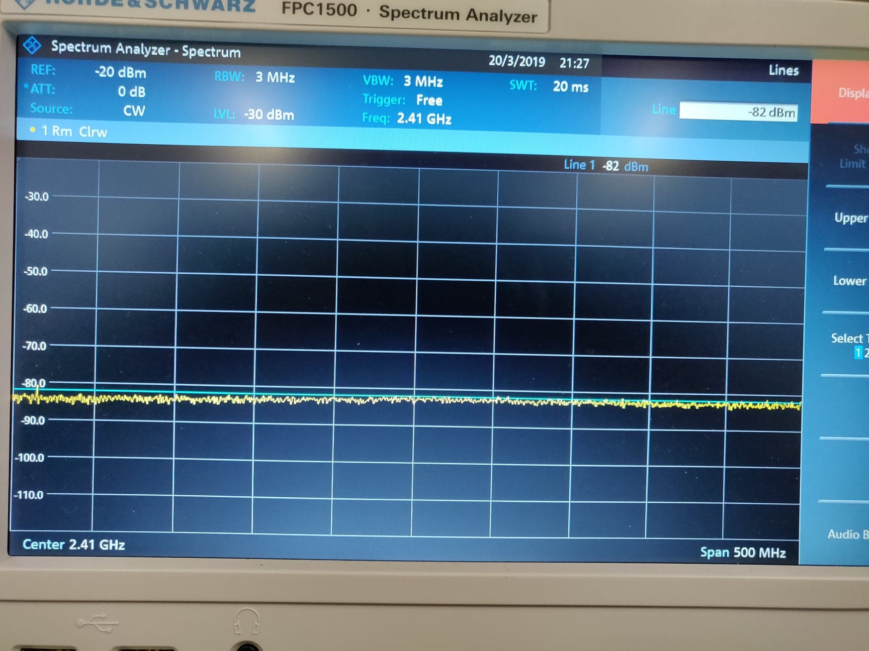
Environment Noise
Environment noise:
-82 dBm

Slide 37
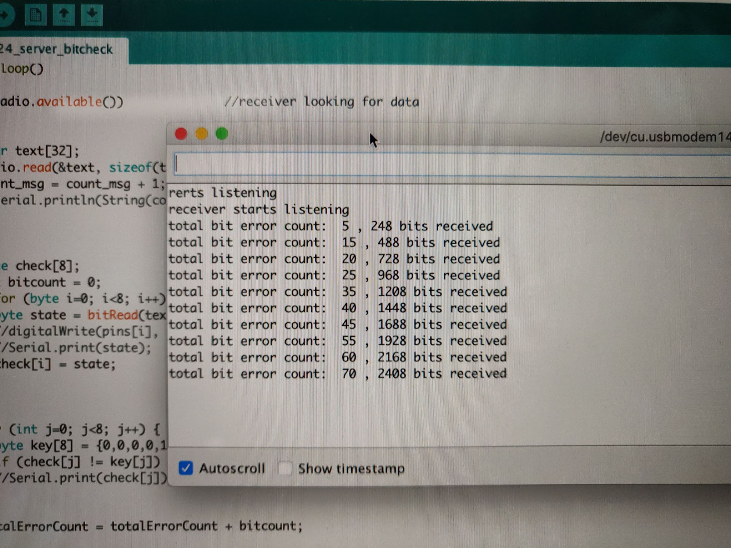
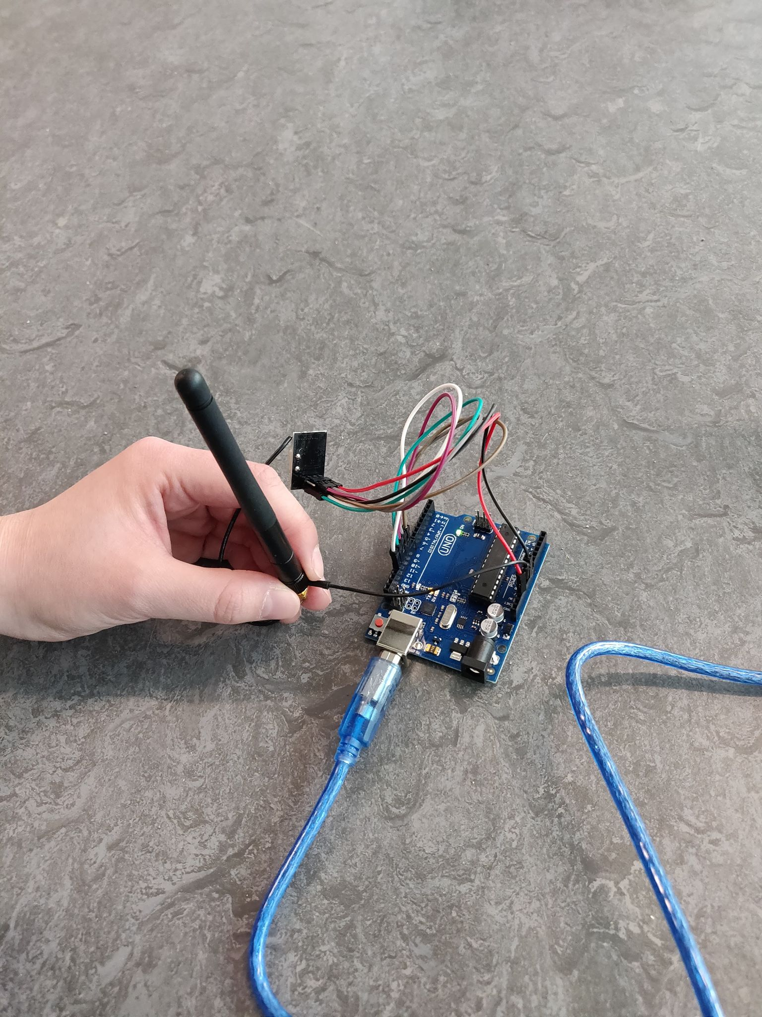
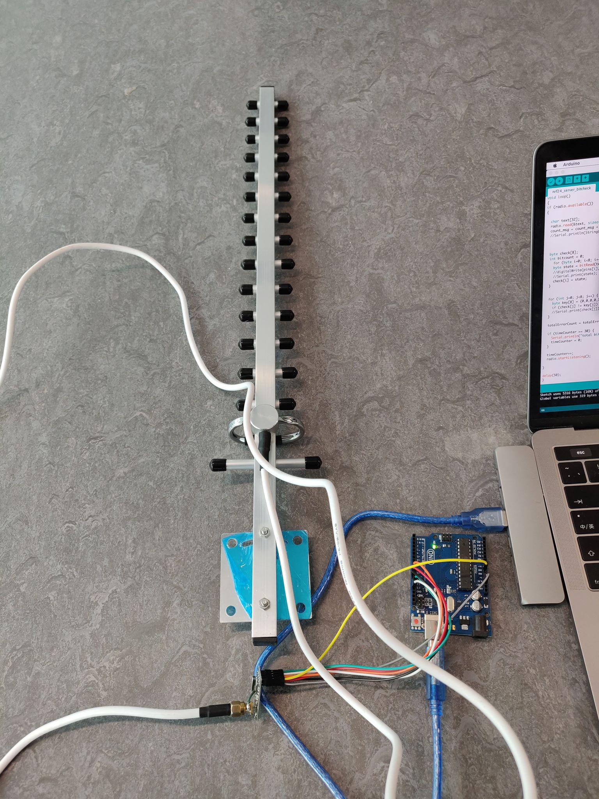
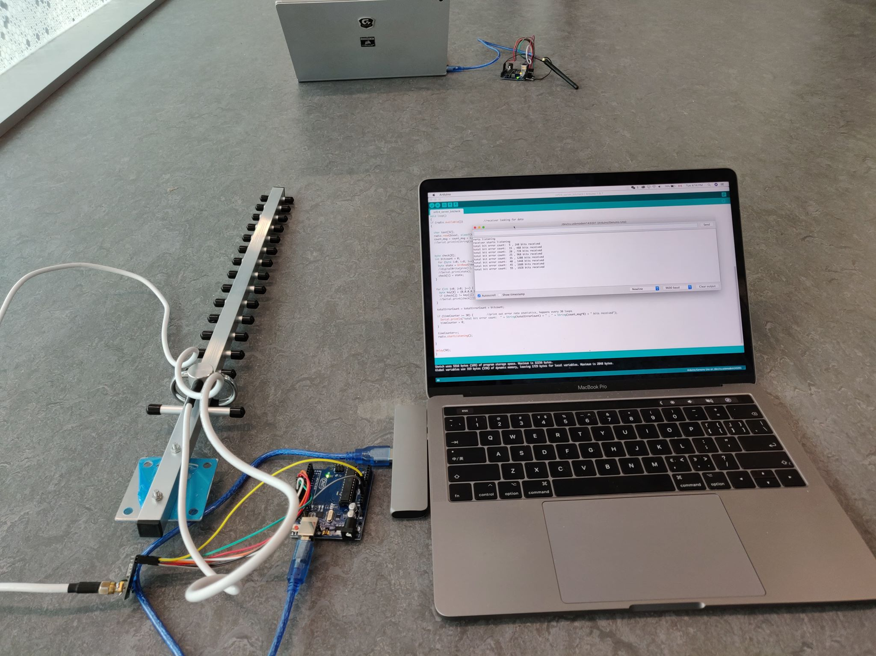

Slide 38
Table of Contents
Background Information
Modulation Scheme Tradeoff
Component Selection
Link Budget
Constraints
Prototype Design
Prototype Functionality
Questions

Slide 39
Prototype Functionality
Establish 2-way communication between two transceivers to transmit messages
1. Packet Loss
2. Bit Error Rate

Slide 40
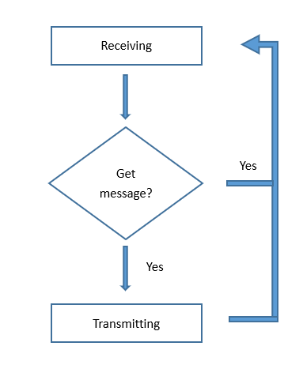
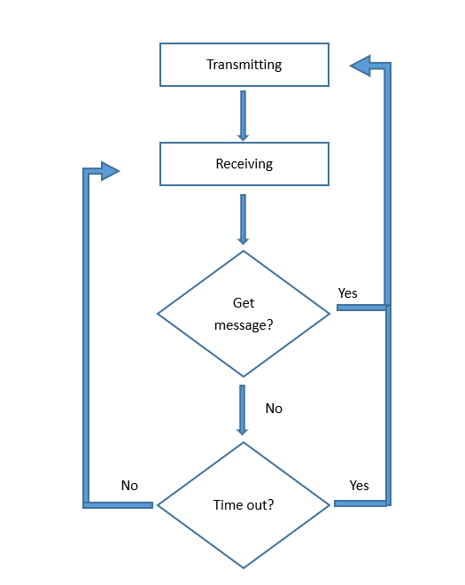
Packet Loss Calculation
Client
Server
Server sends back ACK when messages are received
After 20 messages, “END” message is sent to indicate end of transmission set Packet loss rate is calculated based on how many packets are received

Slide 41
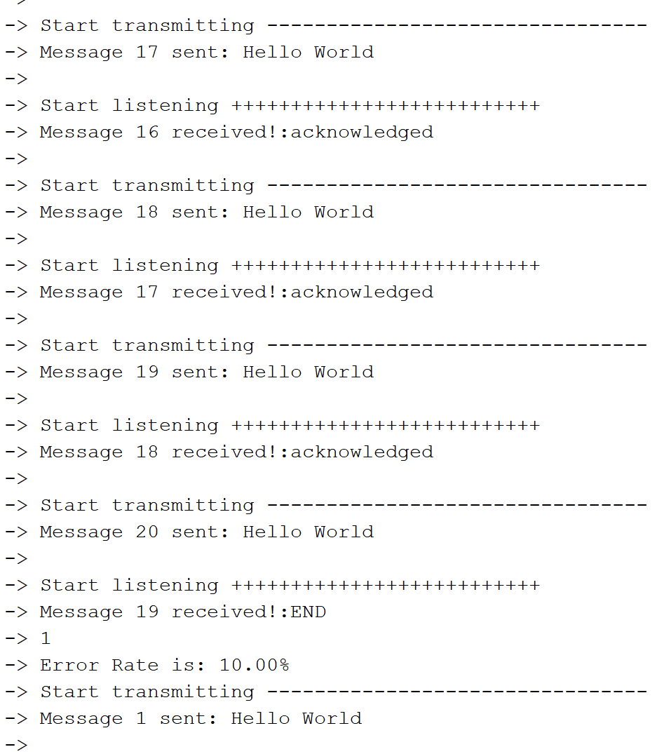
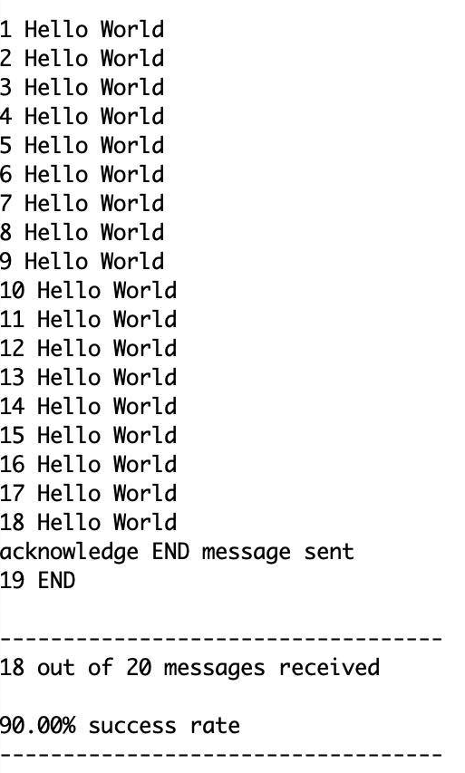
Packet Loss Calculation

Slide 42
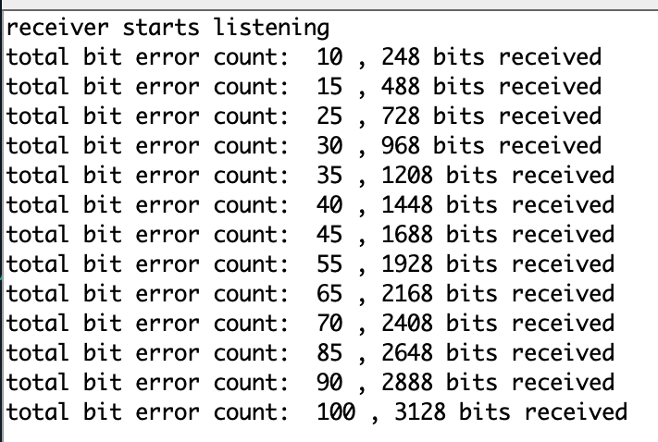
Bit Error Rate
Client continuously sends “0”, server check if received message is correct as individual bits

Slide 43
Bit Error Rate
distance (m) | bits sent | bits received | bits lost | received bit error | total bit error | bit error rate
0 | 4800 | 4568 | 232 | 143 | 375 | 8%
10 | 4800 | 3128 | 1672 | 100 | 1772 | 37%
20 | 4800 | 2648 | 2152 | 77 | 2229 | 46%
30 | 4800 | 1928 | 2872 | 66 | 2938 | 61%
40 | 4800 | 1208 | 3592 | 40 | 3632 | 76%
50 | 4800 | 488 | 4312 | 21 | 4333 | 90%
60 | 4800 | 0 | 4800 | 0 | 4800 | 100%

Slide 44
Table of Contents
Background Information
Modulation Scheme Tradeoff
Component Selection
Link Budget
Constraints
Prototype Design
Prototype Functionality
Questions

Slide 45
Questions?

